Slide 1
Query Processing and Optimization
Introduction
Phases of Query Processing
Optimization Methods

Slide 2
Introduction
In databases that provide low-level access routines such as IMS or flat file databases, the programmer must write code to perform the queries.
With higher level database query languages such as SQL and QUEL, a special component of the DBMS called the Query Processor takes care of arranging the underlying access routines to satisfy a given query.
Thus queries can be specified in terms of the required results rather than in terms of how to achieve those results.

Slide 3
A query is processed in four general steps: Phases of Query Processing
Scanning and Parsing
Query Optimization or planning the execution strategy
Query Code Generator (interpreted or compiled)
Execution in the runtime database processor

Slide 4
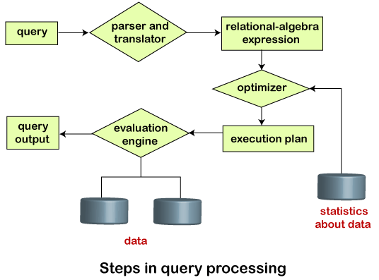
Steps in Query Processing

Slide 5
1. Scanning and Parsing
When a query is first submitted (via an applications program), it must be scanned and parsed to determine if the query consists of appropriate syntax.
Scanning is the process of converting the query text into a tokenized representation.
The tokenized representation is more compact and is suitable for processing by the parser.
This representation may be in a tree form.
The Parser checks the tokenized representation for correct syntax.
In this stage, checks are made to determine if columns and tables identified in the query exist in the database and if the query has been formed correctly with the appropriate keywords and structure.
If the query passes the parsing checks, then it is passed on to the Query Optimizer.

Slide 6
2. Query Optimization or Planning the Execution Strategy
For any given query, there may be a number of different ways to execute it.
Each operation in the query (SELECT, JOIN, etc.) can be implemented using one or more different Access Routines.
For example, an access routine that employs an index to retrieve some rows would be more efficient that an access routine that performs a full table scan.
The goal of the query optimizer is to find a reasonably efficient strategy for executing the query (not quite what the name implies) using the access routines.
Optimization typically takes one of two forms: Heuristic Optimization or Cost Based Optimization
In Heuristic Optimization, the query execution is refined based on heuristic rules for reordering the individual operations.
With Cost Based Optimization, the overall cost of executing the query is systematically reduced by estimating the costs of executing several different execution plans.

Slide 7
3. Query Code Generator (interpreted or compiled)
Once the query optimizer has determined the execution plan (the specific ordering of access routines), the code generator writes out the actual access routines to be executed.
With an interactive session, the query code is interpreted and passed directly to the runtime database processor for execution.
It is also possible to compile the access routines and store them for later execution.

Slide 8
4. Execution in the runtime database processor
At this point, the query has been scanned, parsed, planned and (possibly) compiled.
The runtime database processor then executes the access routines against the database.
The results are returned to the application that made the query in the first place.
Any runtime errors are also returned.

Slide 9
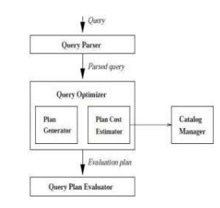
Query Optimization
Query optimization is the process of selecting an efficient execution plan for evaluating the query. After parsing of the query, parsed query is passed to query optimizer, which generates different execution plans to evaluate parsed query and select the plan with least estimated cost. Catalog manager helps optimizer to choose best plan to execute query generating cost of each plan.

Slide 10
1. Cost based Optimization (Physical)
This is based on the cost of the query. The query can use different paths based on indexes, constraints, sorting methods etc. This method mainly uses the statistics like record size, number of records, number of records per block, number of blocks, table size, whether whole table fits in a block, organization of tables, uniqueness of column values, size of columns etc.

Slide 11
Example: Cost based Optimization (Physical)
Suppose, we have series of table joined in a query.
T1 ∞ T2 ∞ T3 ∞ T4∞ T5 ∞ T6
For above query we can have any order of evaluation. We can start taking any two tables in any order and start evaluating the query. Ideally, we can have join combinations in (2(n-1))! / (n-1)! ways. For example, suppose we have 5 tables involved in join, then we can have 8! / 4! = 1680 combinations. But when query optimizer runs, it does not evaluate in all these ways always. It uses Dynamic Programming where it generates the costs for join orders of any combination of tables. It is calculated and generated only once. This least cost for all the table combination is then stored in the database and is used for future use. i.e.; say we have a set of tables, T = { T1 , T2 , T3 .. Tn}, then it generates least cost combination for all the tables and stores it.

Slide 12
2. Heuristic Optimization (Logical)
This method is also known as rule based optimization. This is based on the equivalence rule on relational expressions; hence the number of combination of queries get reduces here. Hence the cost of the query too reduces. This method creates relational tree for the given query based on the equivalence rules. These equivalence rules by providing an alternative way of writing and evaluating the query, gives the better path to evaluate the query.

Slide 13

Example: Heuristic Optimization (Logical)
Suppose we have a query to retrieve the students with age 18 and studying in class DESIGN_01. We can get all the student details from STUDENT table, and class details from CLASS table. We can write this query in two different ways.
Here both the queries will return same result. But when we observe them closely we can see that first query will join the two tables first and then applies the filters. That means, it traverses whole table to join, hence the number of records involved is more. But the second query, applies the filters on each table first. This reduces the number of records on each table (in class table, the number of record reduces to one in this case!). Then it joins these intermediary tables. Hence the cost in this case is comparatively less.

Slide 14


